Slide 1


TITLE:
Operating System
By:
Syed Mustafa Ahmed - BCS183102

Slide 2
Goals:
To somewhat “Emulate” an early Operating System e.g MSDos
Create Classes that Mimic the structure of an actual OS
Impliment Functions similar to Legacy Operating Systems
Achieve these goals using concepts of OOP

Slide 3
Functionality:
Command line input
Directory change
File Handling i.e : File creation, editing, display and deletion
Commands bound to OS for system state
One-step Basic Mathematical Calculations
Login Screen & Security
Encryption of Data e.g : Username & Password
Proper File Structures (similar to actual OS)
Example of Multimedia playback
Public release, Direct .exe run and iso file

Slide 4
SECTIONS:
Operating System

Slide 5
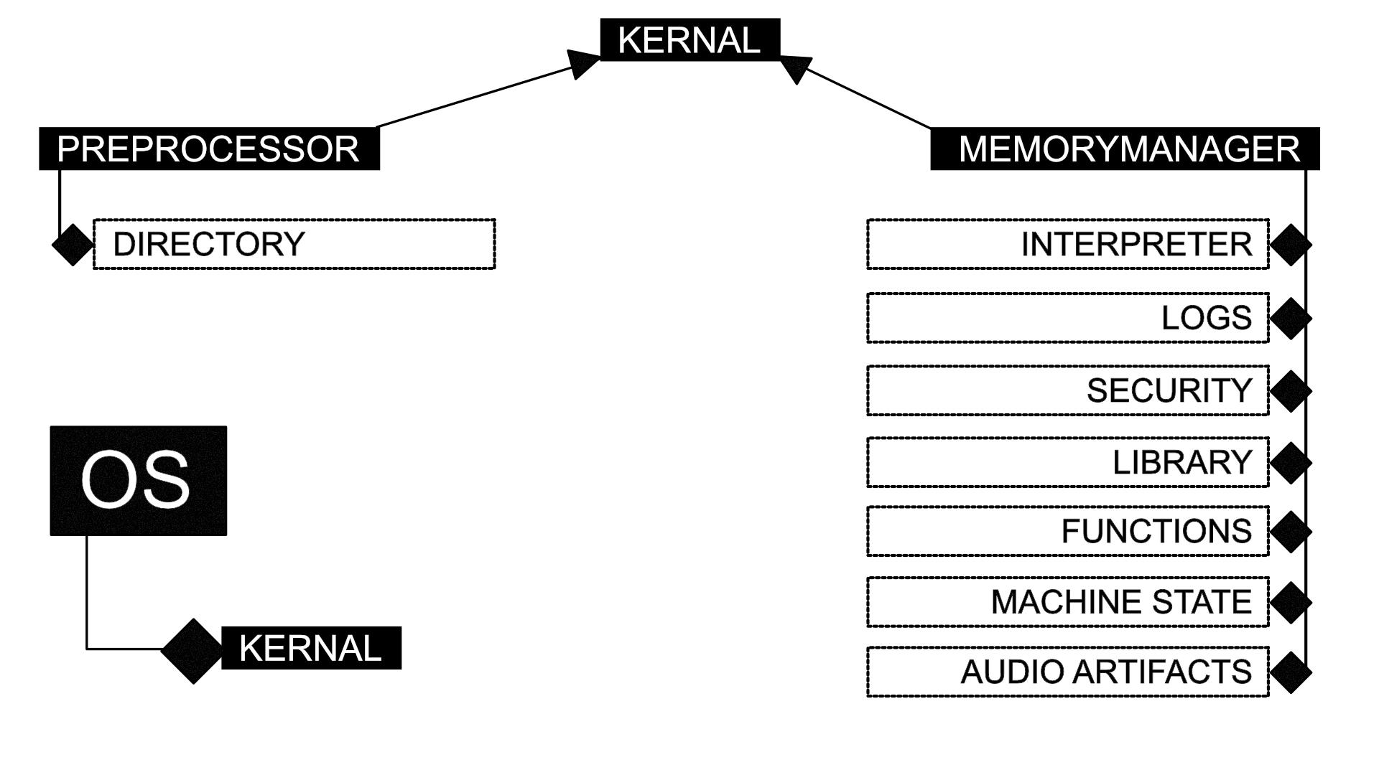

Slide 6
CLASS DIAGRAM:
Operating System

Slide 7
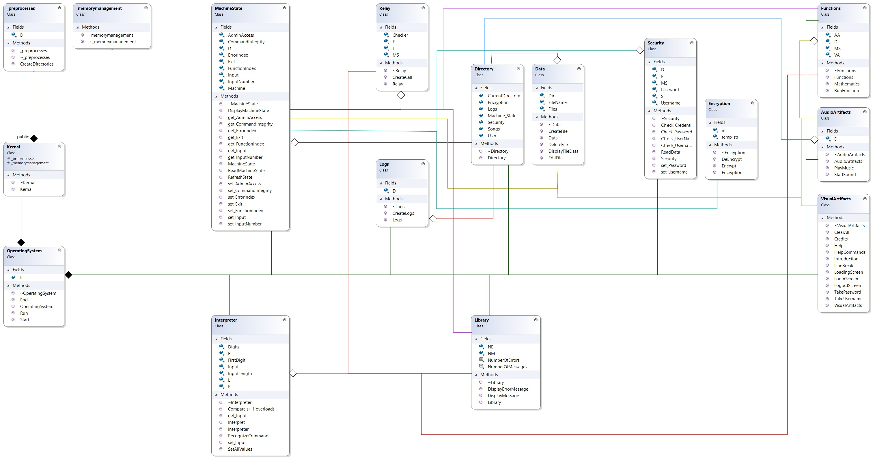

Slide 8
FLOW:
Operating System

Slide 9
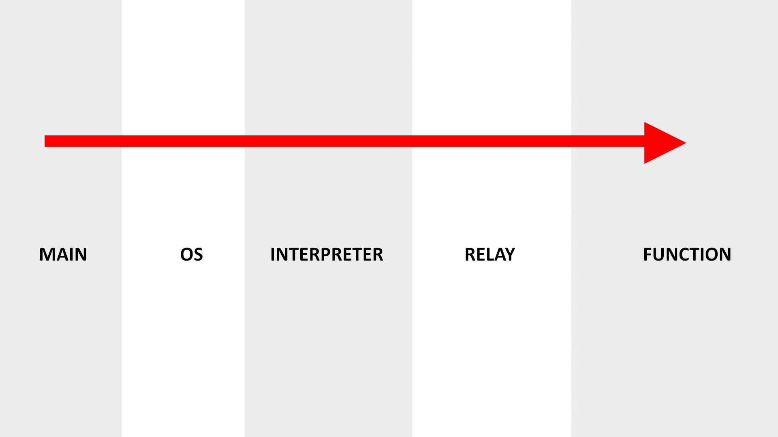

Slide 10
THANKYOU!
Demo Time ...
+ Questions & Answers

